Slide 1



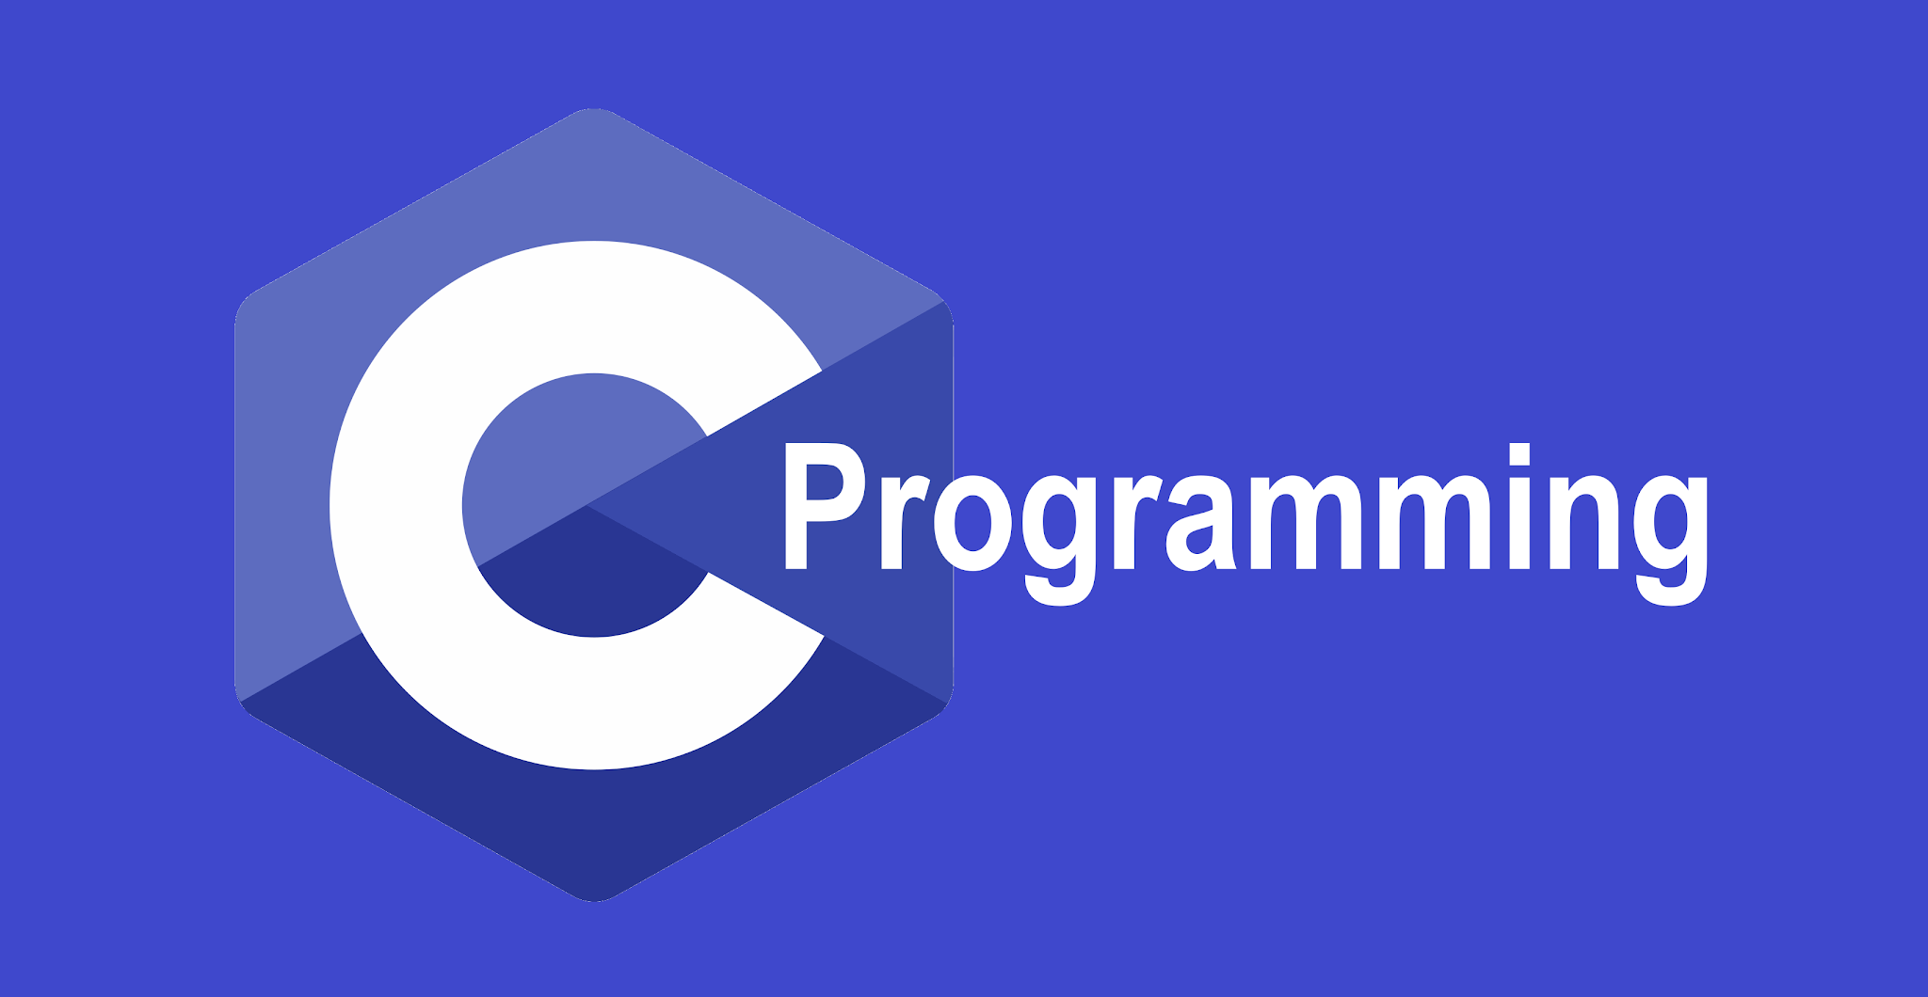

LEARNING PROGRAMMING LANGUAGES- a roadmap for beginners

Slide 2

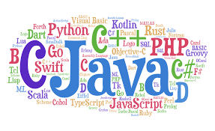
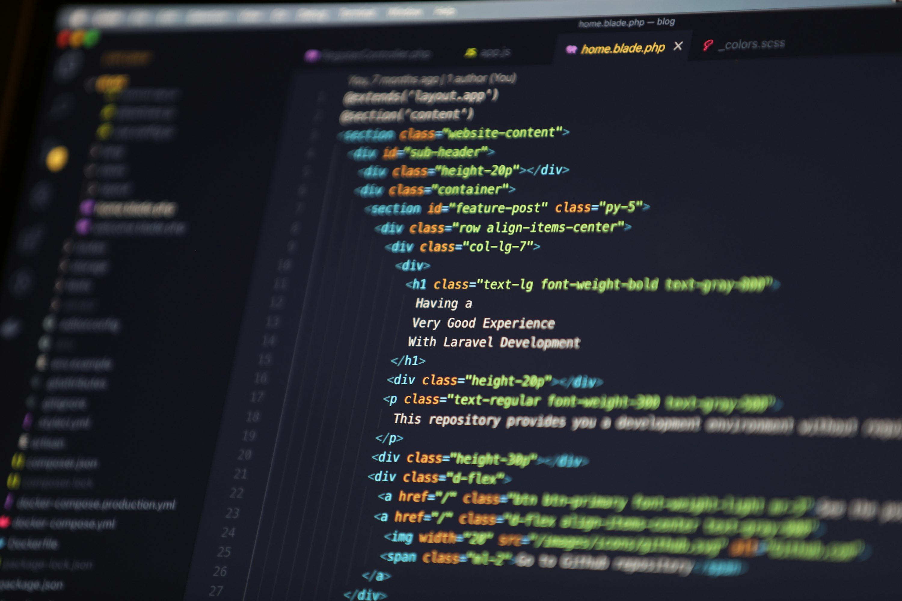
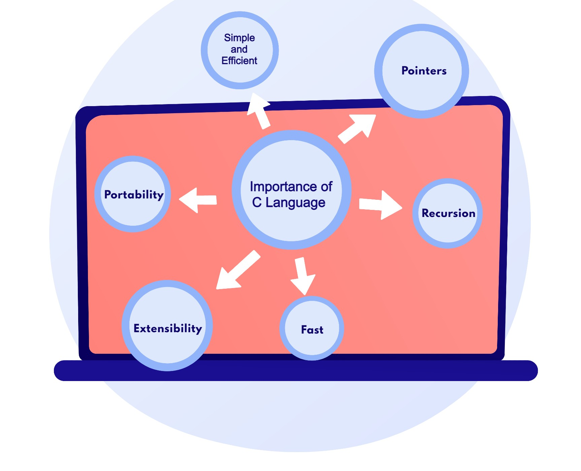
INTRODUCTION-
What is a programming language?
A way to communicate with computers.
Two main categories:
Low level language (C)
High level language (Python ,Java)

Slide 3

Comparison of popular languages-
Language | Ease of learning | Speed | Usage
C | Medium | Very fast | Systems Programming
Python | Very easy | Slower | AI, Web dev
Java | Medium | Fast | Enterprise software
Javascript | Easy | Medium | Web development

Slide 4

Steps to learn any language:
Learn syntax (variables, loops , functions).
Practice problem solving (small projects).
Explore libraries and frameworks.
Work on real – world projects.

Slide 5

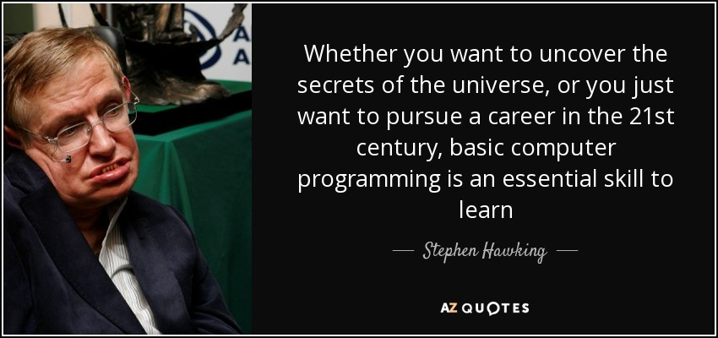
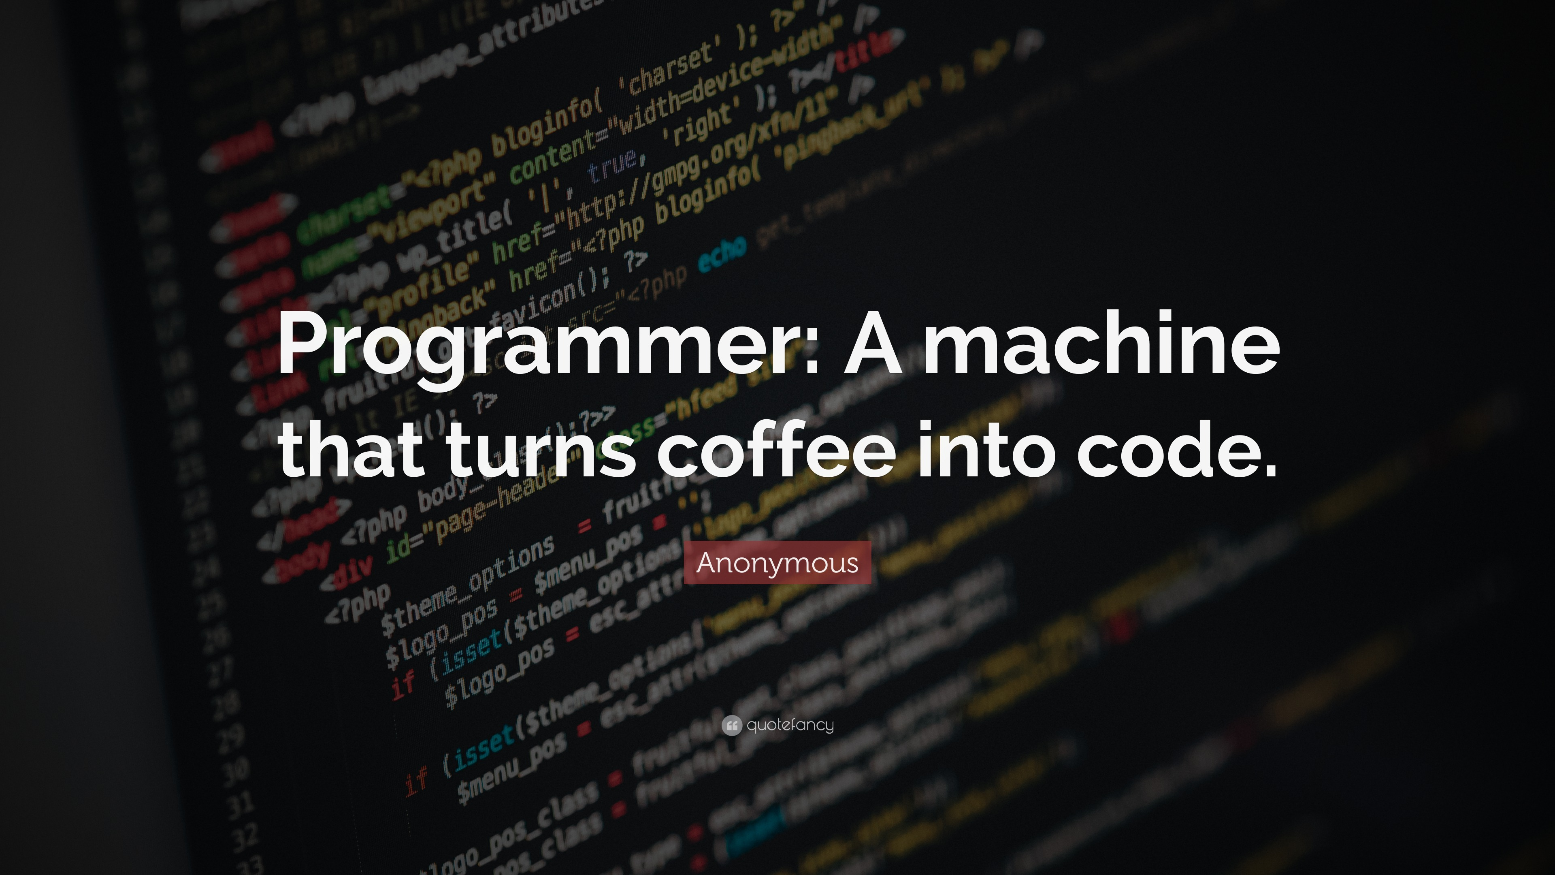
Conclusion & motivation-
No single "best" language – choose based on goals.
Programing is about logic , not just syntax.
Consistency & practice = mastery.
We can practice these languages at any online platforms for ex.link to learn c

